Slide 1
Version Control
Essential Tool & Practice

Slide 2
Version Control
Version Control : managing versions of files
Primitive version
  Use copies of files:
    Resume.doc.bak
    Resume-2006.doc
    Resume-2007.doc
  Issues
    Multiple users
    Granularity
    Identifying changes

Slide 3
Version Control Systems
Version Control System : software to perform advanced version control
  Examples:
    Visual Team Foundation Server
    CVS
    Subversion
    Git

Slide 4
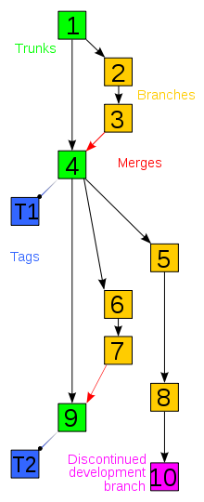
Version Control Concepts
A repository stores snapshots of
files
Branches may contain alternate
versions, experimental features…
  May eventually be merged with
  main trunk
Software can code roll back to
any point
  Sometimes just undo a single step

Slide 5
Conflict Resolution
Handling conflicts
  Locking - only one person has writable copy of file at a time
    Bottlenecks
  Merging – allow multiple writers and try to reconcile
    Tool can help
    Human has to decide on conflicts
    Difficult merges may require one party to redo

Slide 6
Effective version control
Sync early and often
  Everyone owns the code
  Siloed code becomes impossible to merge
Protect the build
  Do NOT sync code that does not work

Slide 7
In practice
Sync before starting anything new
Work in small chunks
Build and test changes
Sync when working
If you break the build or have to do something long
  Branch

Slide 8
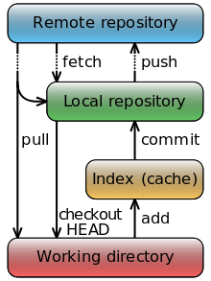
Git
Source control system designed for Linux kernal
Server stores master copies of code
Checkout local version (repository)
  Make edits to files
  Commit changes to include them in
  local repository
  Push changes to remote server

Slide 9
What goes in source control
Anything/Everything!
Text based files are best behaved
  Source code
  Config files
  SQL scripts
Binary files are impossible to merge
  Modifying is all or nothing
  Git will automatically exclude some files (generated code)

Slide 10
GitHub
GitHub : online repository for Git projects
  Free if you keep your source code open (for read)
Instructions :
  Make an account at GitHub.com
    Recommendation:
      Linfield email address
      Username : jsmithLinfield
  One person makes a repository
    Do in windows client…
  Add others as collaborators

Slide 11
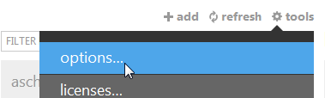
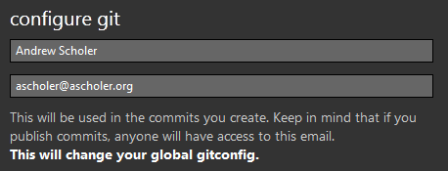
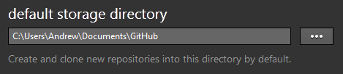
GitHub for Windows
Easy client for github
  Can't do everything
Download & Install
After logging in, MUST
go to Tools/Options
Set name and email & default storage loc:

Slide 12
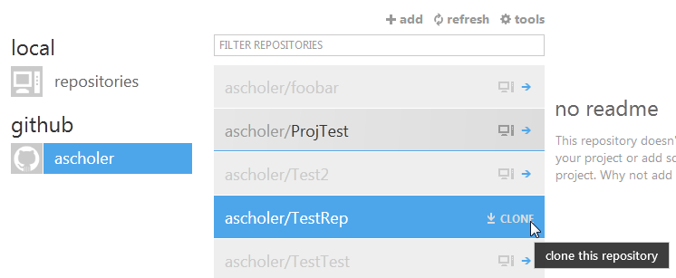
Basics
Click on github to find respository
  Clone it

Slide 13

Sync
Sync before you work:

Slide 14
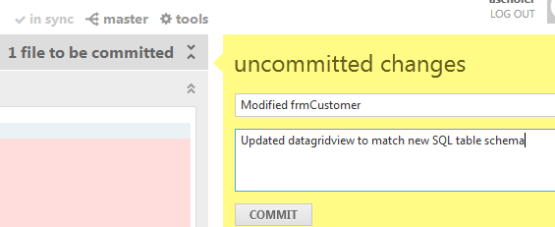
Commit
Make changes in the project – test them
After testing a logical group of changes, Commit them:

Slide 15
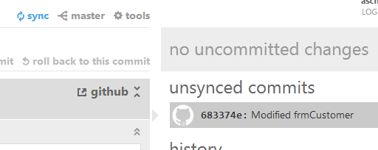
Sync commits
Share your changes to the repository by Syncing

Slide 16
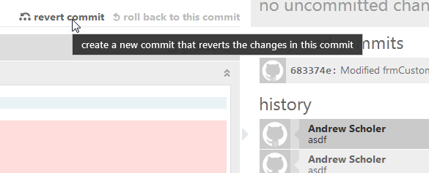
Undo
Revert commit can undo one particular commit:
  Makes a new commit
  Changes files to undo changes from that step
  OK to do to historical actions

Slide 17
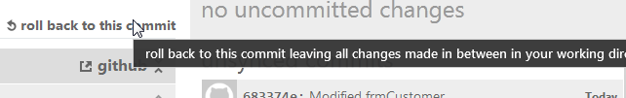
Rollback
Rollback says "oops – I didn't want to make that commit"
  Keeps changes you have made
  Just clears that commit action
  Does not work on synched commits!

Slide 18
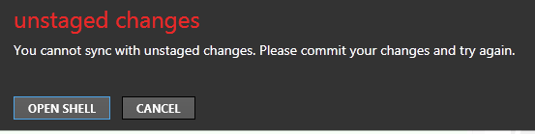
I screwed up!!!
Have changes you do not want to keep:
Easiest (most drastic) solution
  Delete local repository
  Reclone

Slide 19


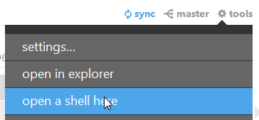
Reset
To reset – removing local changes:
Select top of history:
Copy the code for that snapshot:
Do Tools→Open Shell

Slide 20
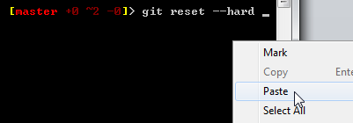

Reset 2
In shell, type:
git reset --hard CODE
For code, paste in the code for the state at the top of the history:
All is well:

Slide 21
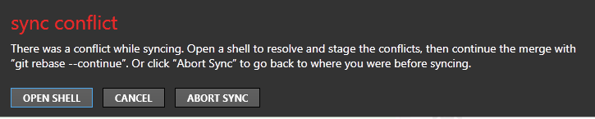
Merge problem
On conflict you will see:
Press Abort Sync
  Open shell puts you in a state where you need to manually merge files

Slide 22
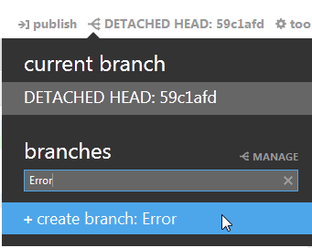
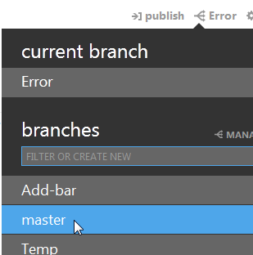
New branch
Before you do anything – create a branch:
Then switch back to master
Reset it to last synched point

Slide 23
Redo
Redo your changes against newly synched Master
  Switch back and forth to Error branch if you need to see what you did
Do not publish your error branch
To delete your branch when done with it, open shell and do:
git branch –D BRANCHNAME

Slide 24
Error
When in doubt
  Restart GitHub for Windows
If still in doubt
  Delete local repository - reclone

